Slide 1
Convolutional Neural Networks
Fundamentals
Anurag srivastava

Slide 2

How does a computer identify an image?

Slide 3
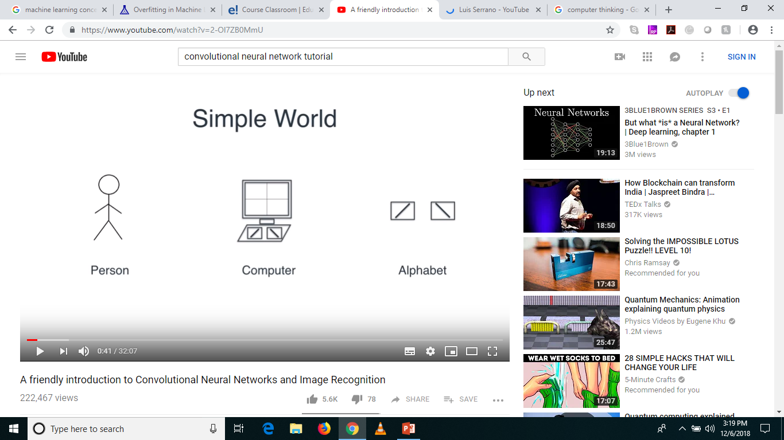
A Simple World

Slide 4
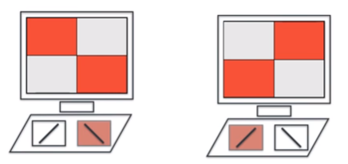
Using the Keyboard

Slide 5
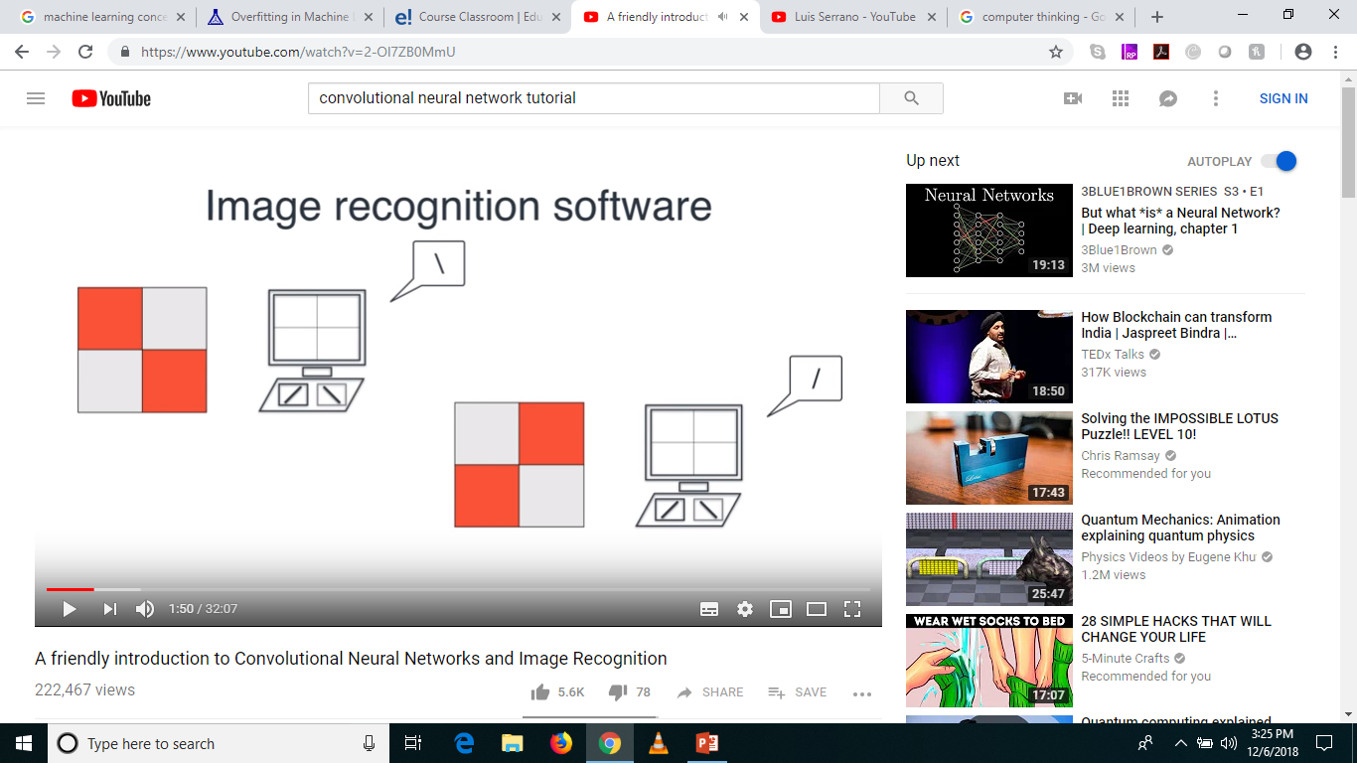

Let’s build an Image Recognition Classifer

Slide 6
What does a computer see? (Not images)
1
-1
-1
1
-1
1
1
-1
Filters

Slide 7
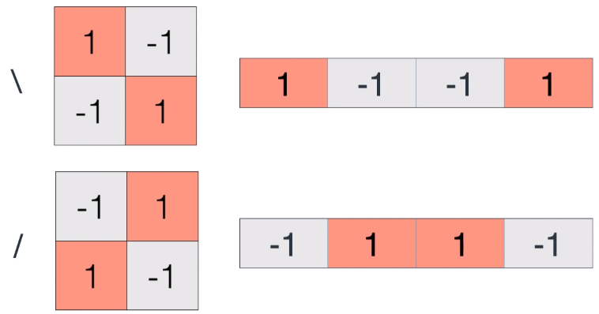
Really?

Slide 8
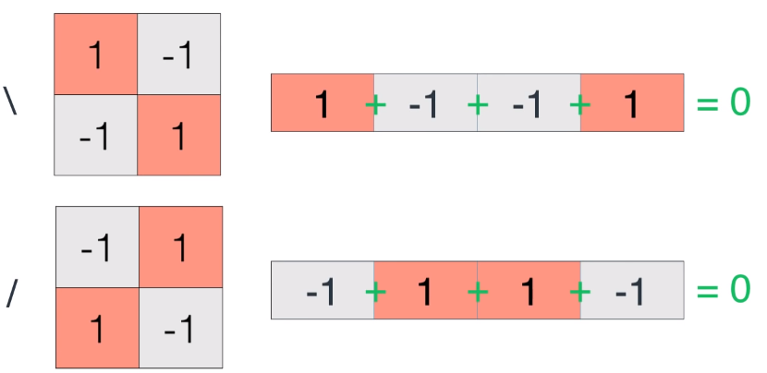

How to tell them apart! … Let’s Add!

Slide 9
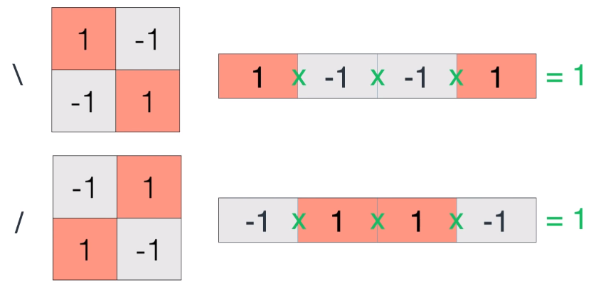
Let’s Multiply!

Slide 10
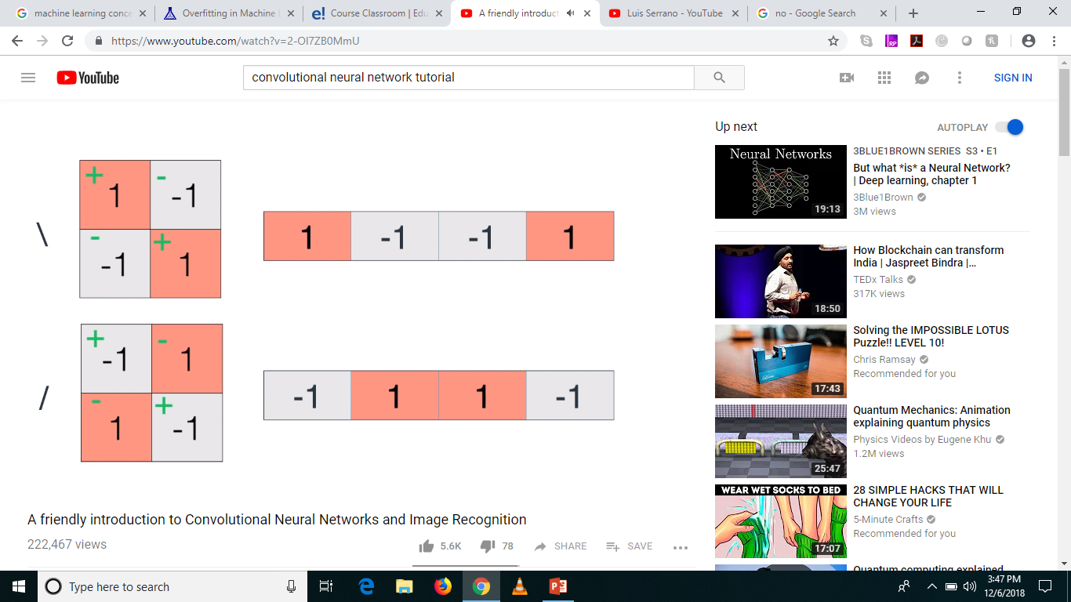

Best option

Slide 11


Let’s see if it works

Slide 12
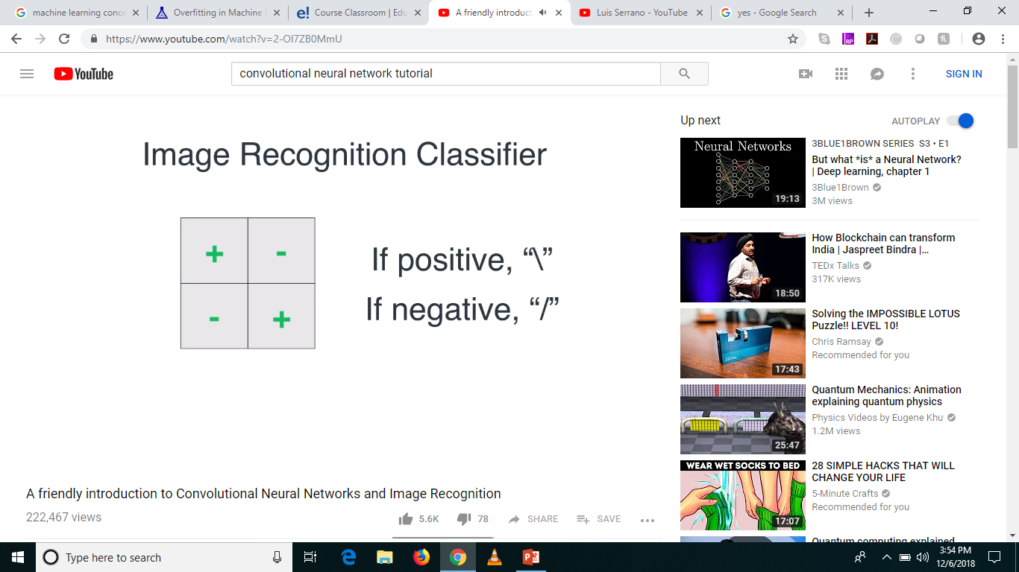
Yay! Our first Image Recognition Classifier!

Slide 13
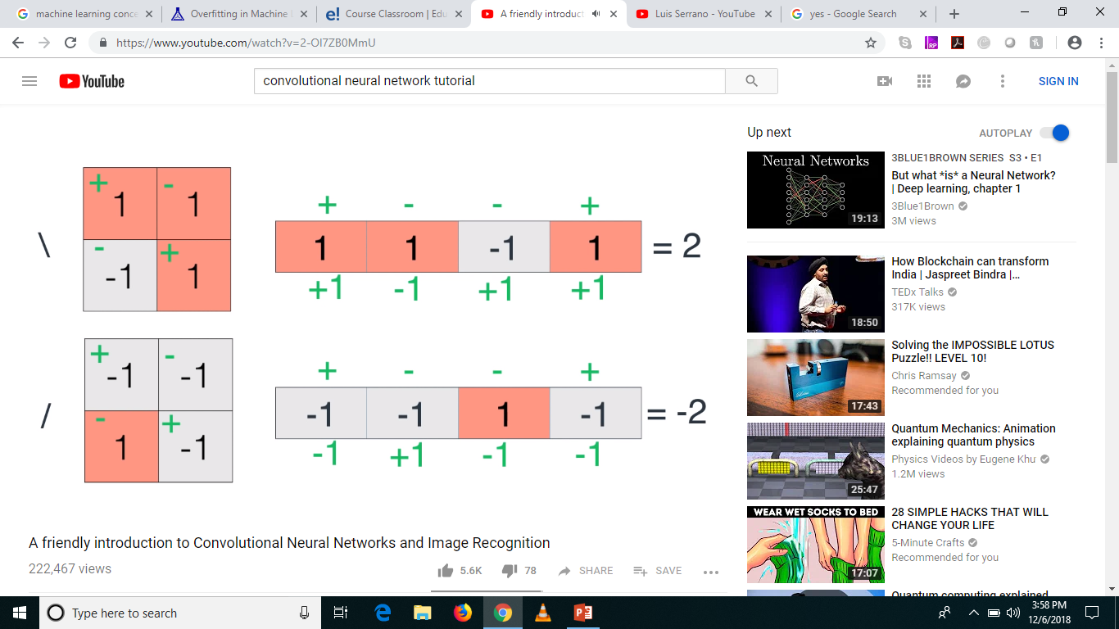
Is our rule generalized? Robust?

Slide 14
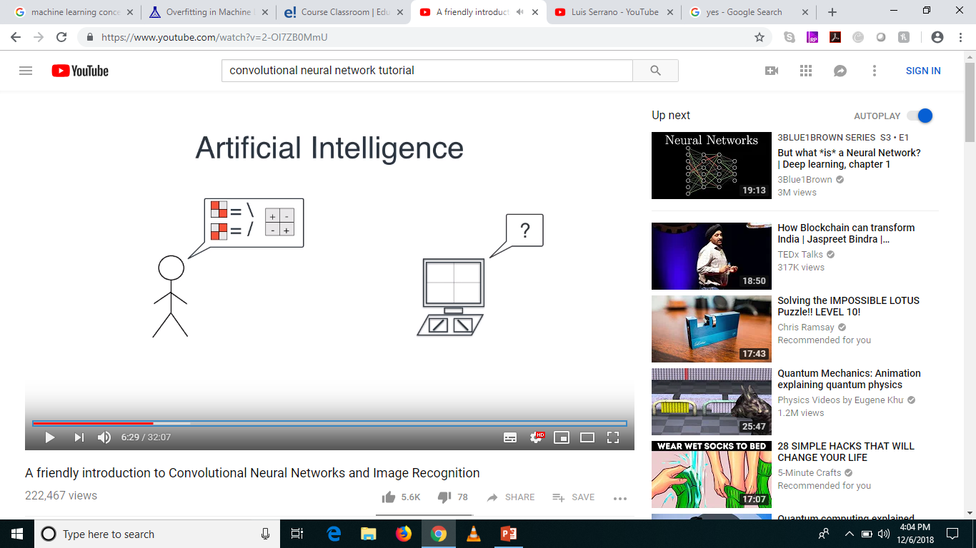
The problem!

Slide 15
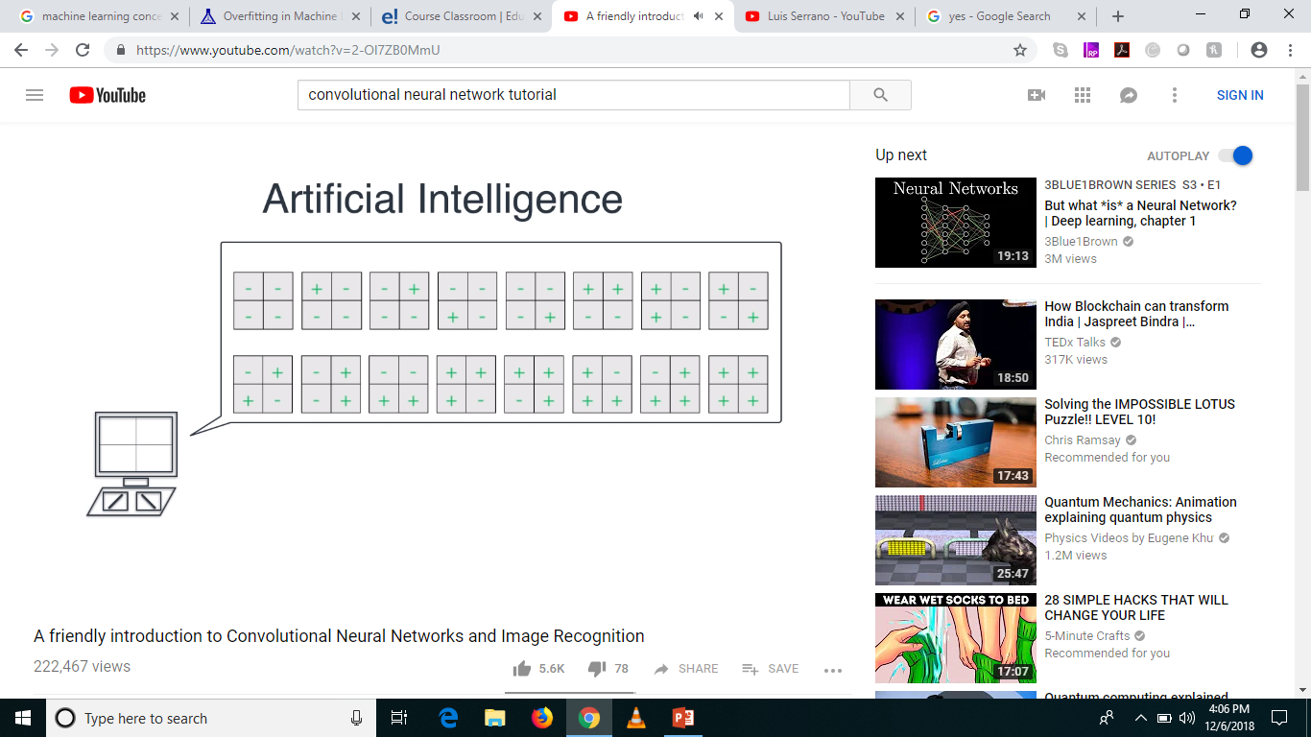
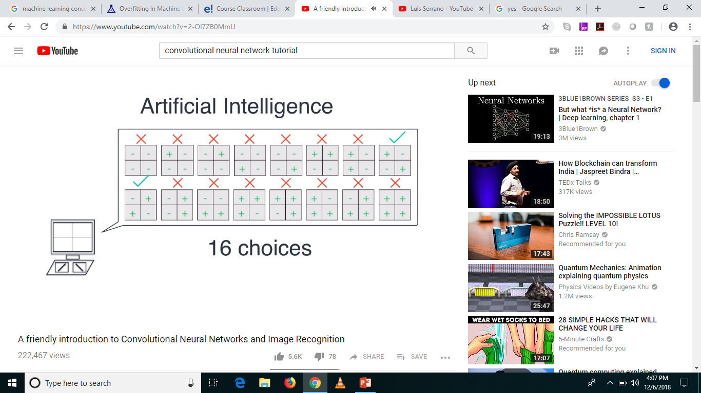
What can the computer do?

Slide 16
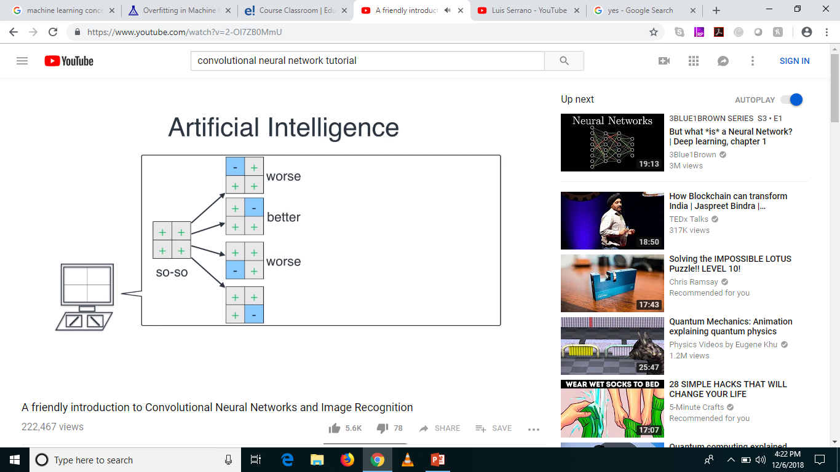

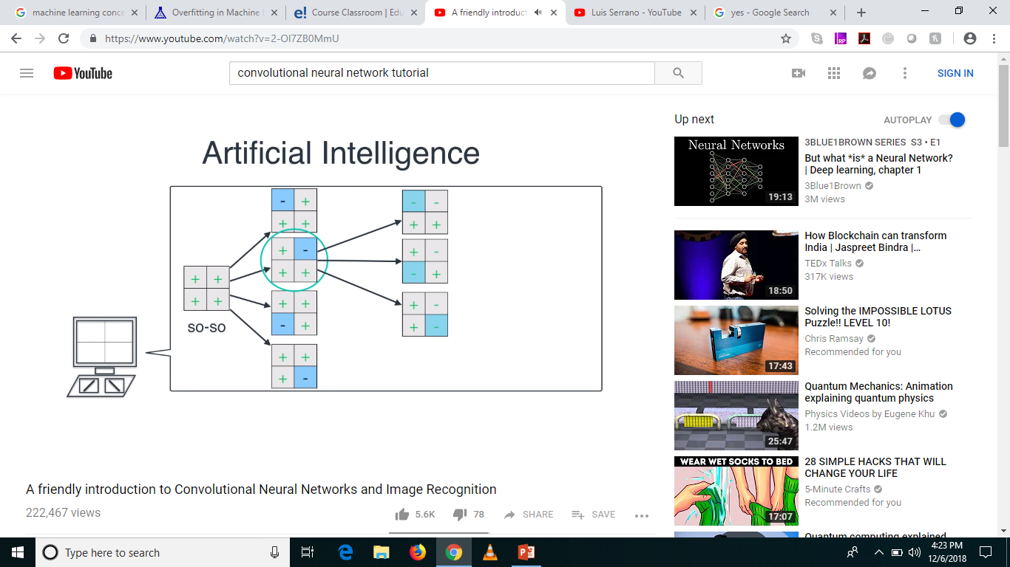


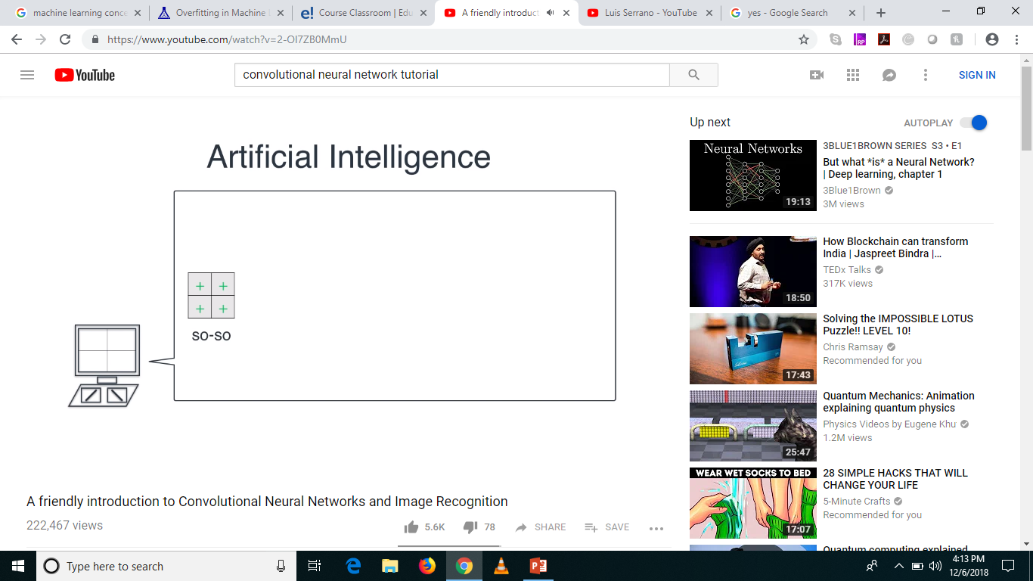


In Reality, its not a Simple World

Slide 17
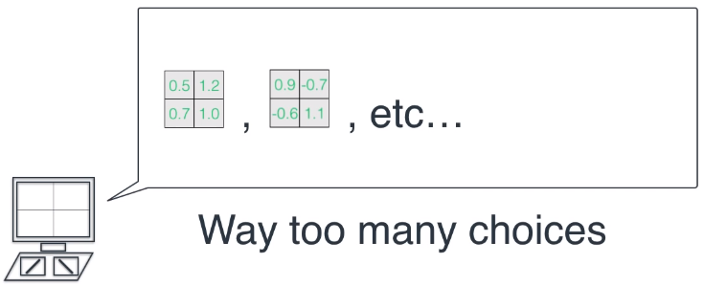
Again, not a Simple World!

Slide 18
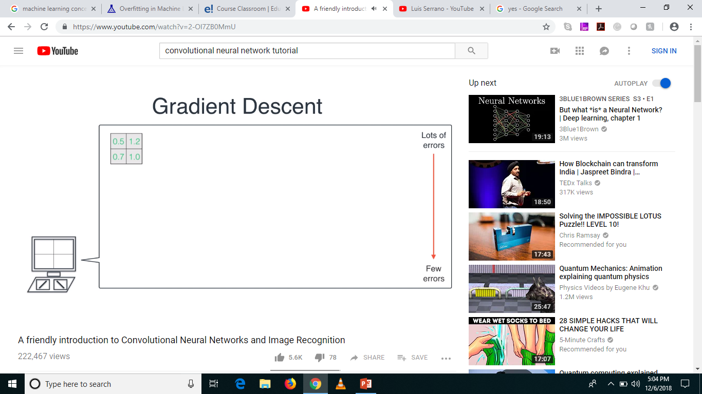
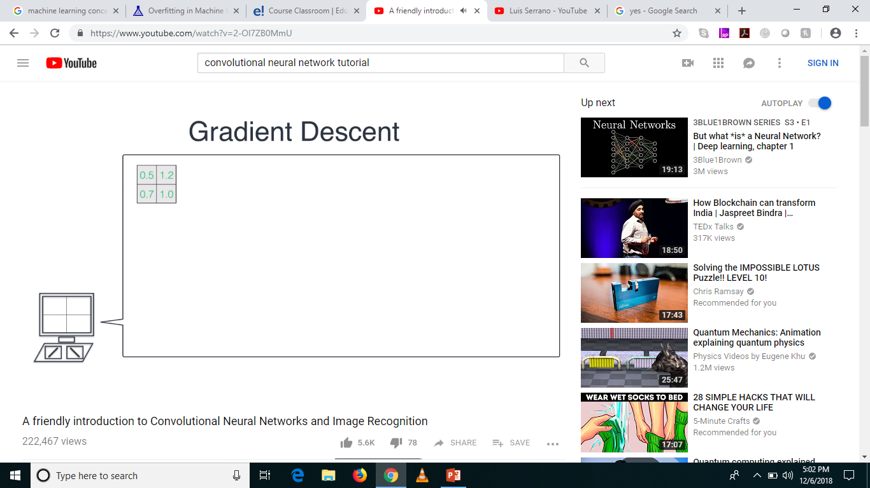
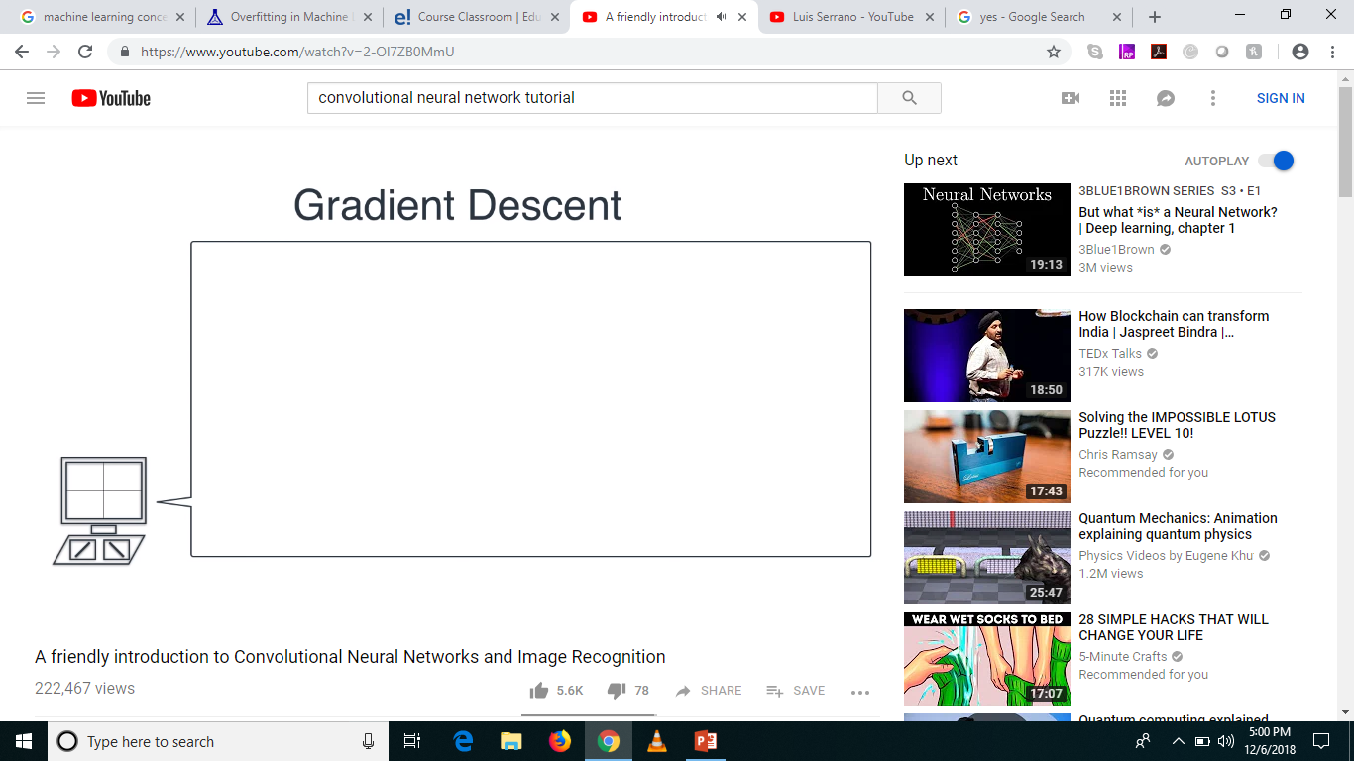



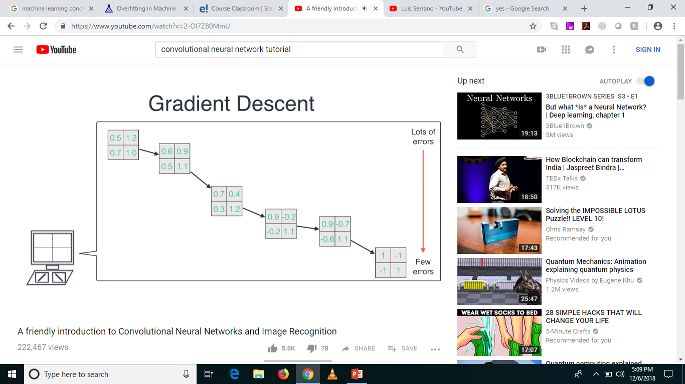

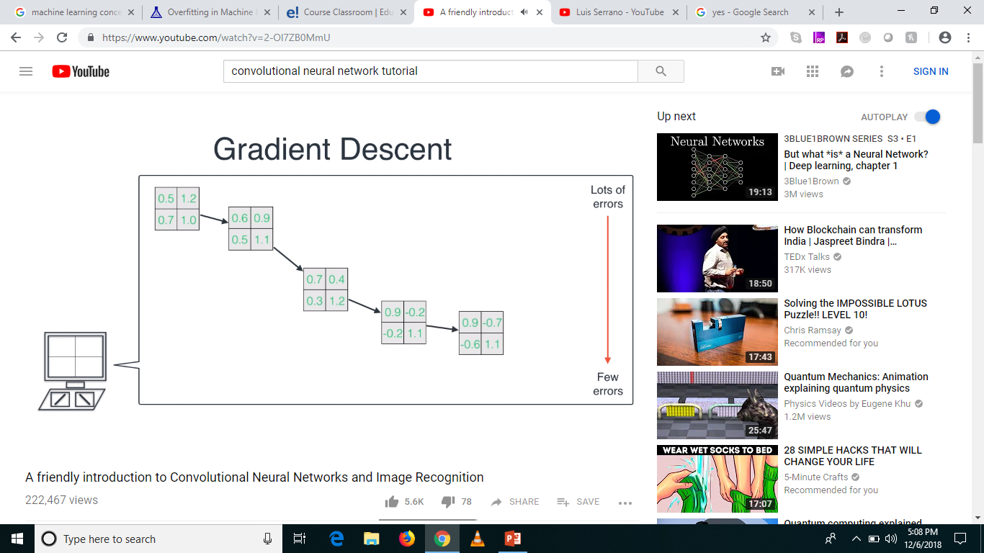
Gradient Descent to the rescue!

Slide 19
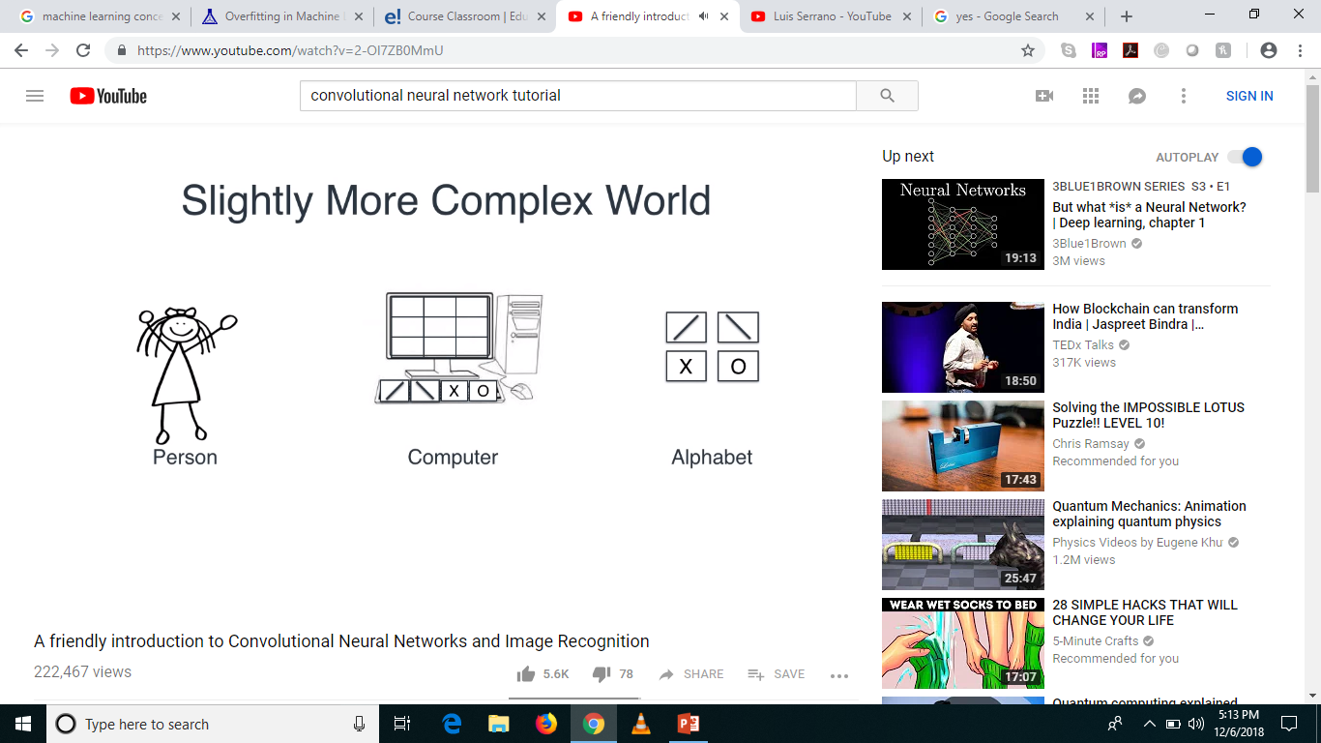
Slightly More Complex World

Slide 20
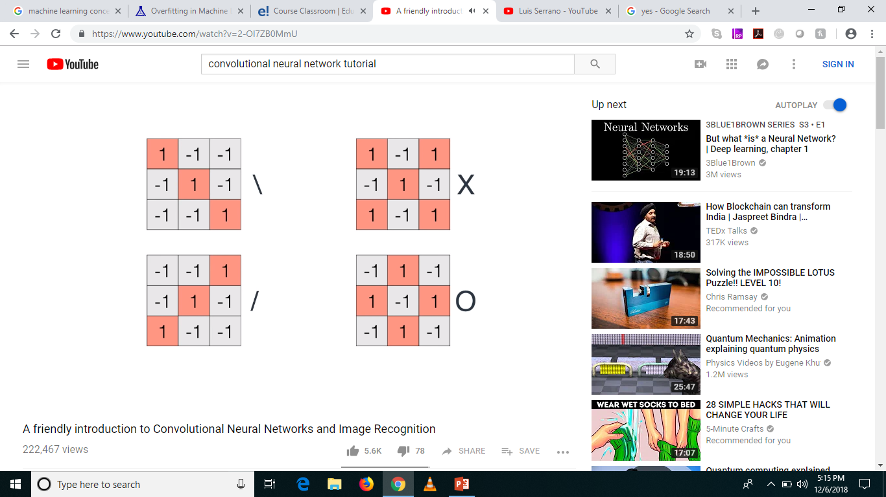
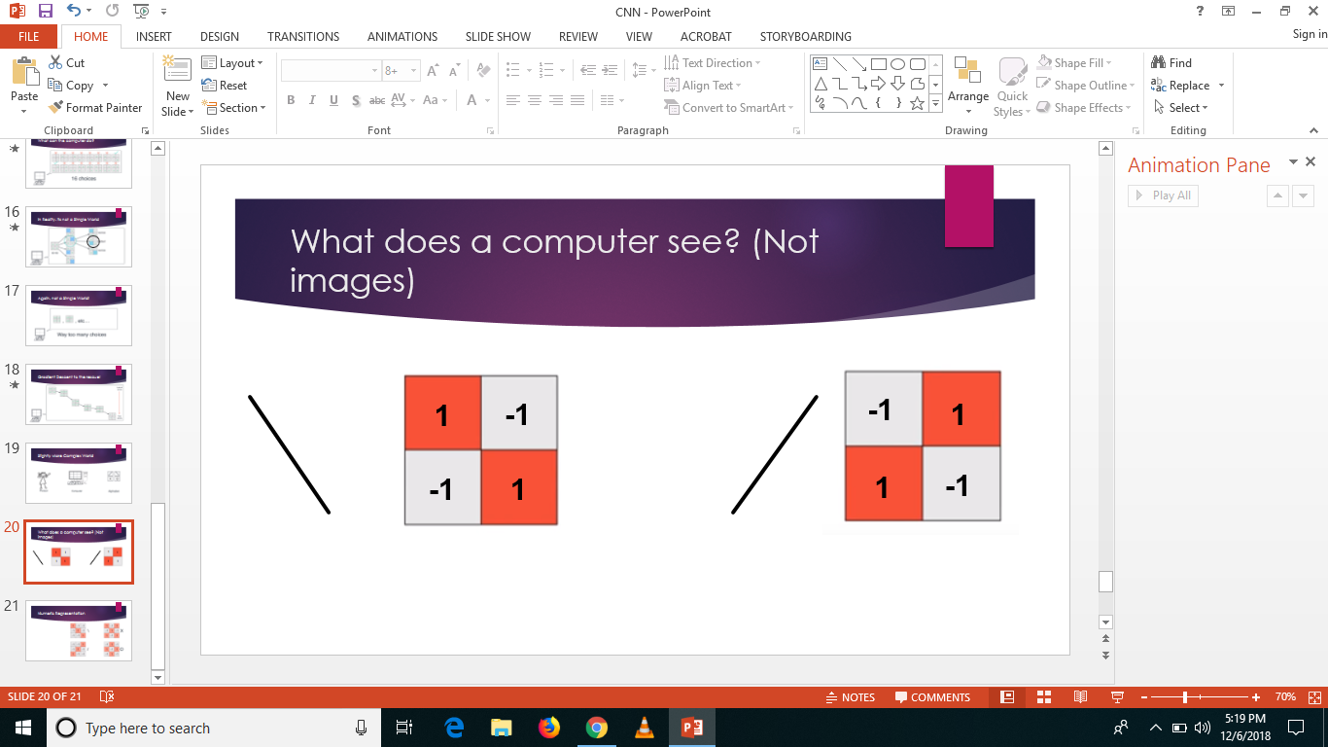
Numeric Representation

Slide 21
Higher Dimensions
Mean higher complexity
More computation difficulty
Simpler the better

Slide 22
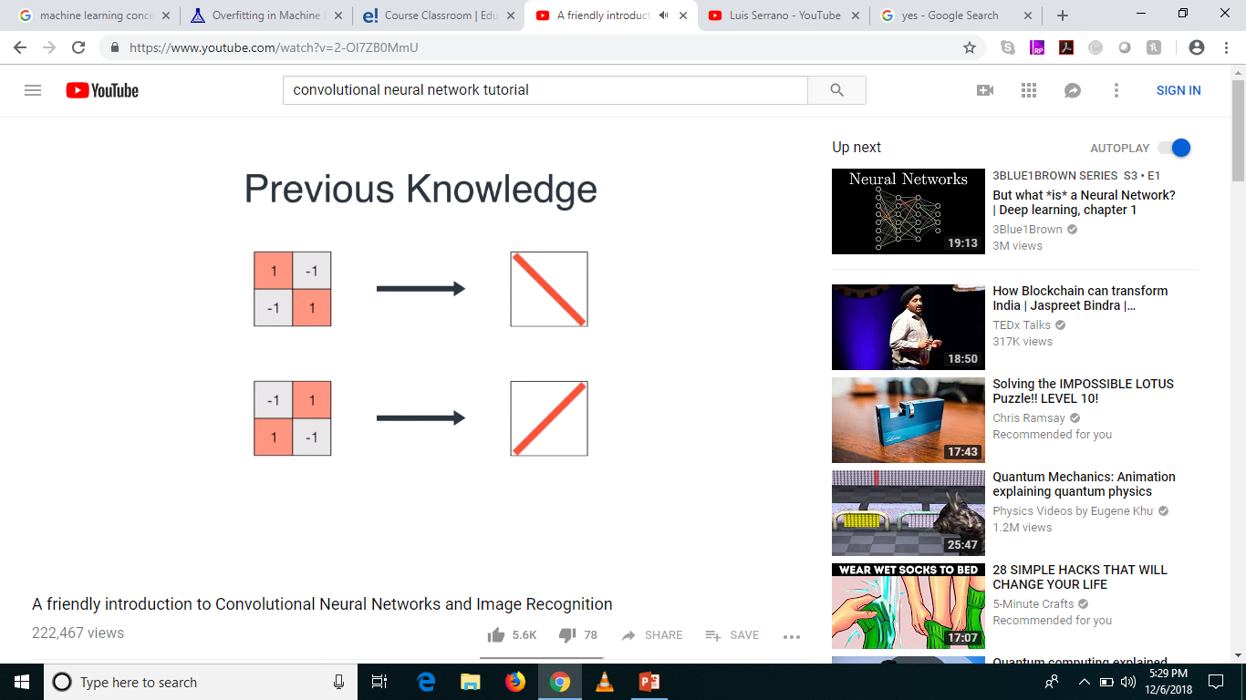
Previous Knowledge

Slide 23
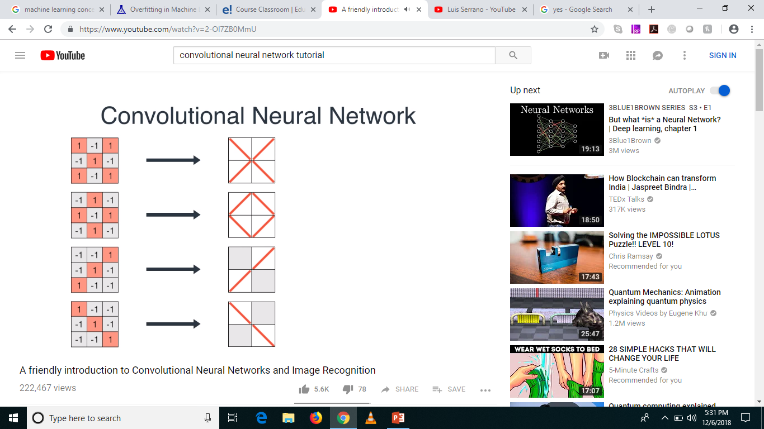
Similarly …

Slide 24
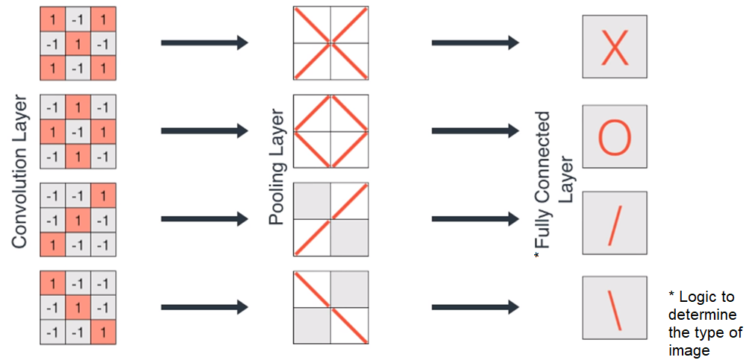
The Layers

Slide 25
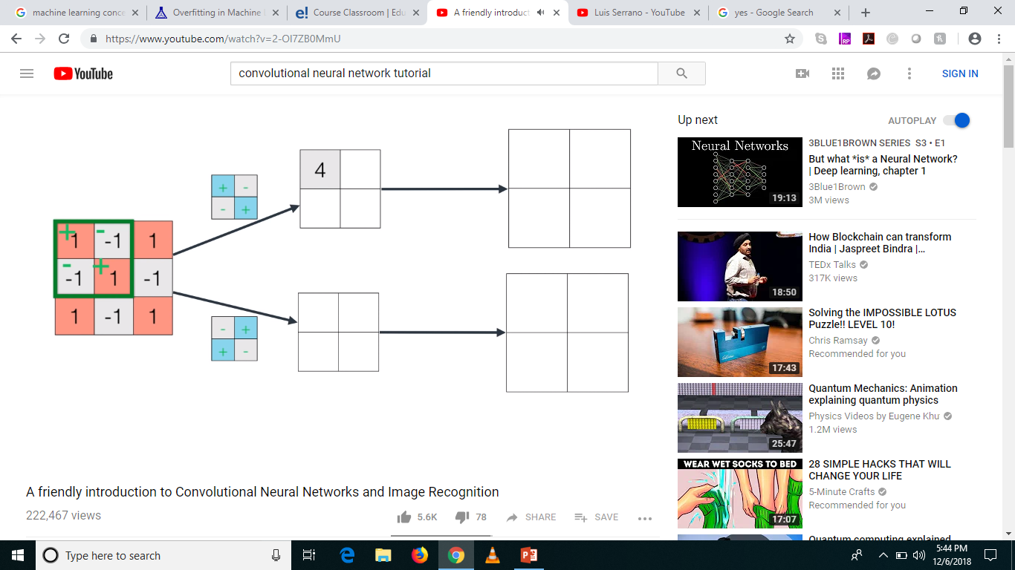
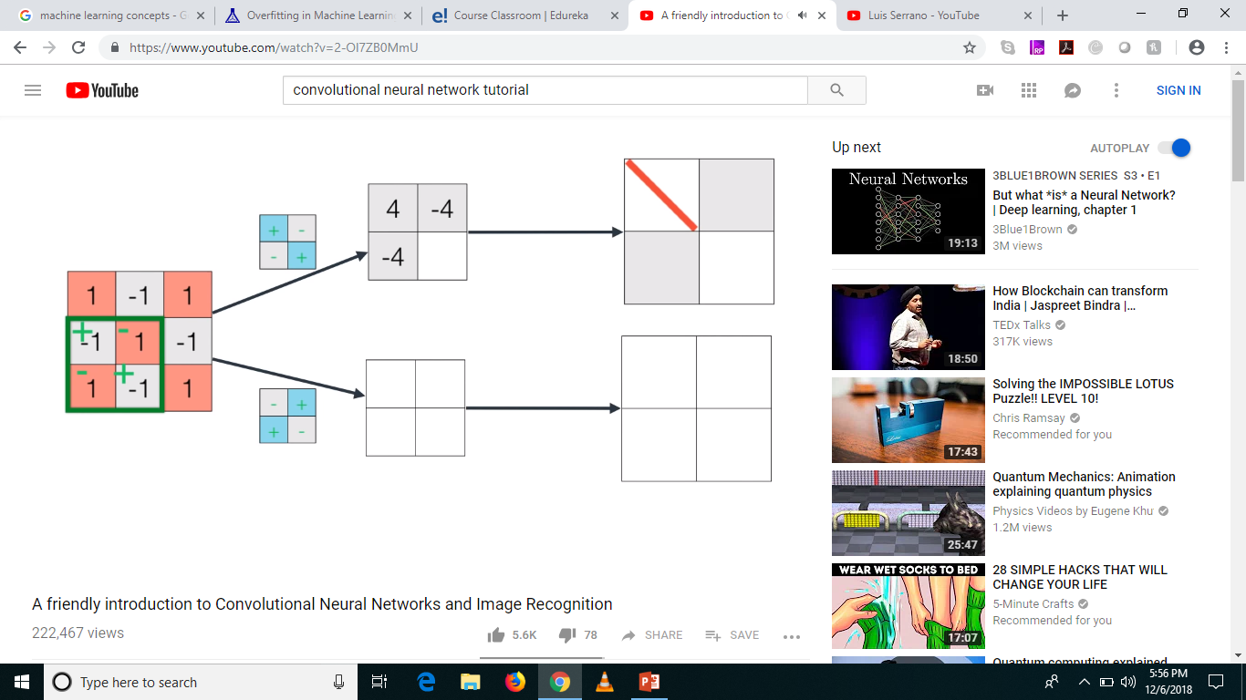
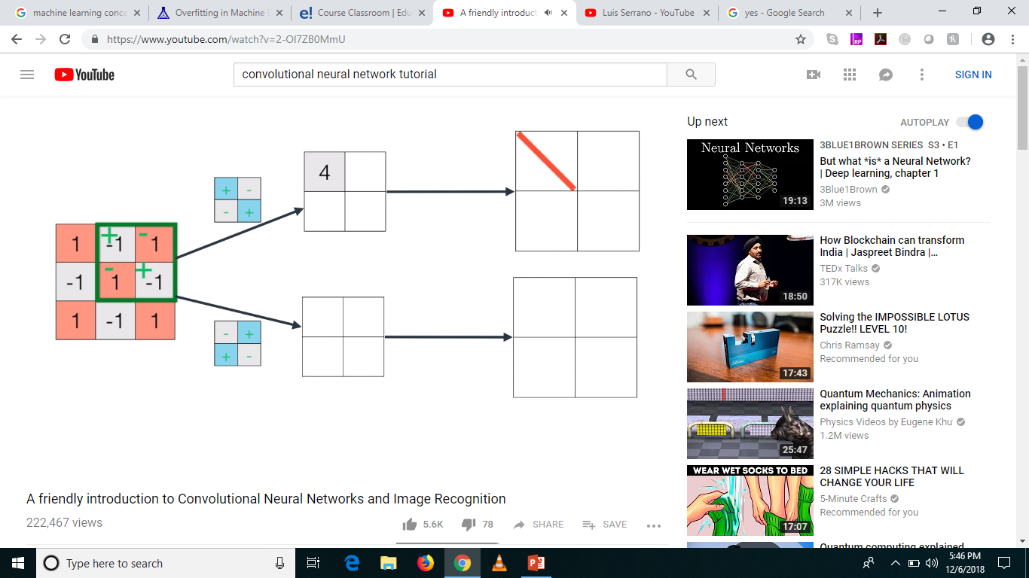
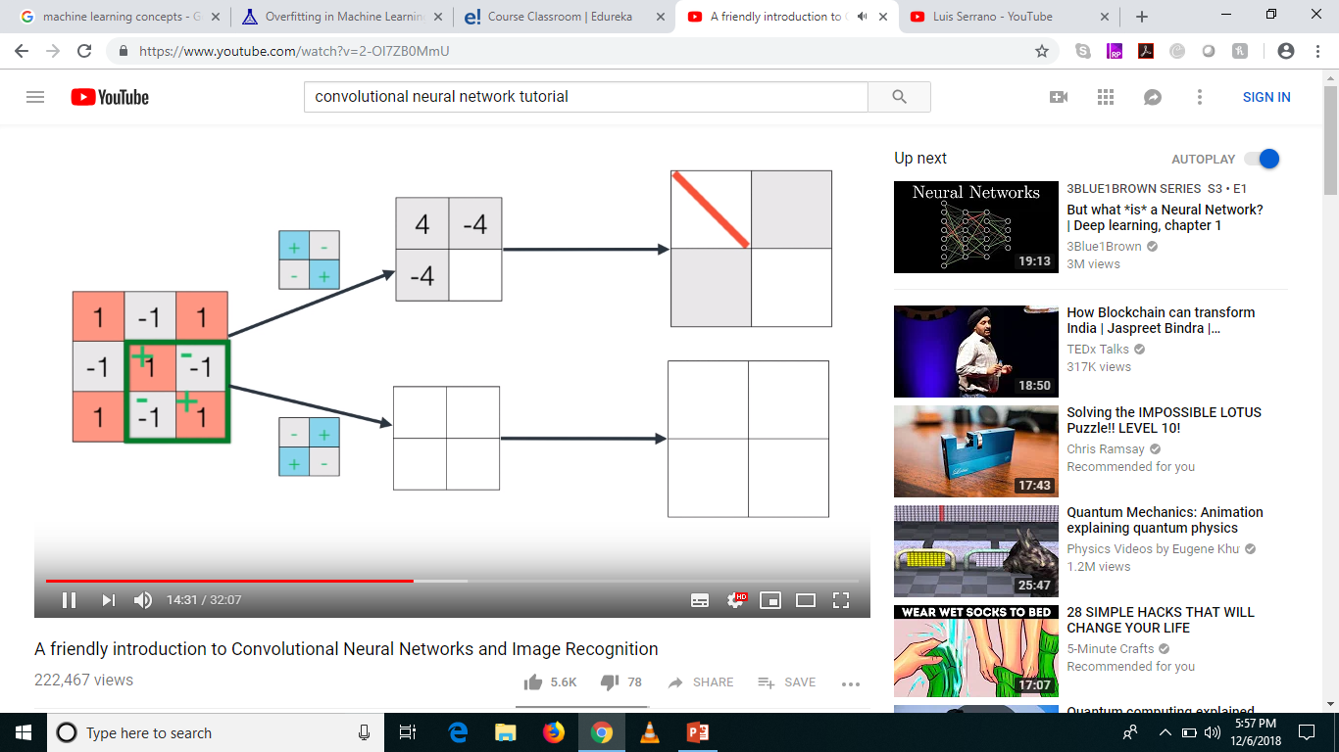
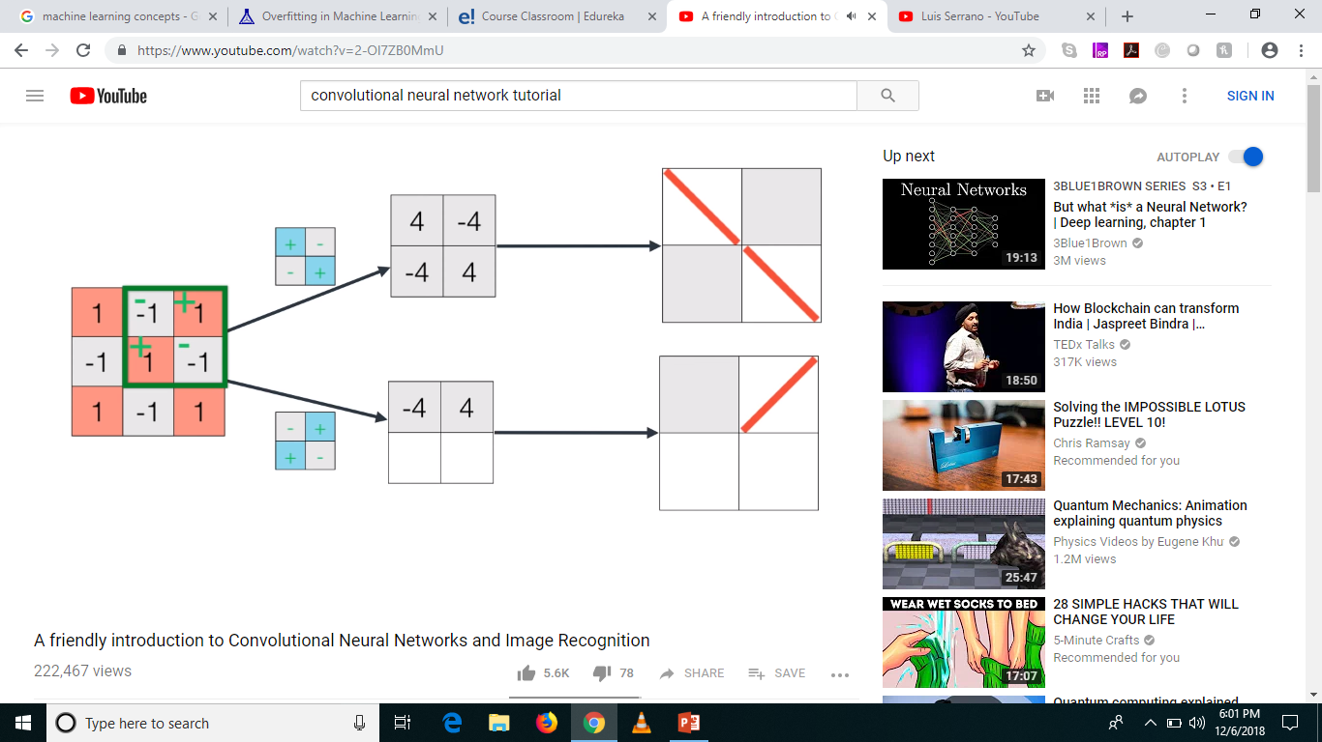



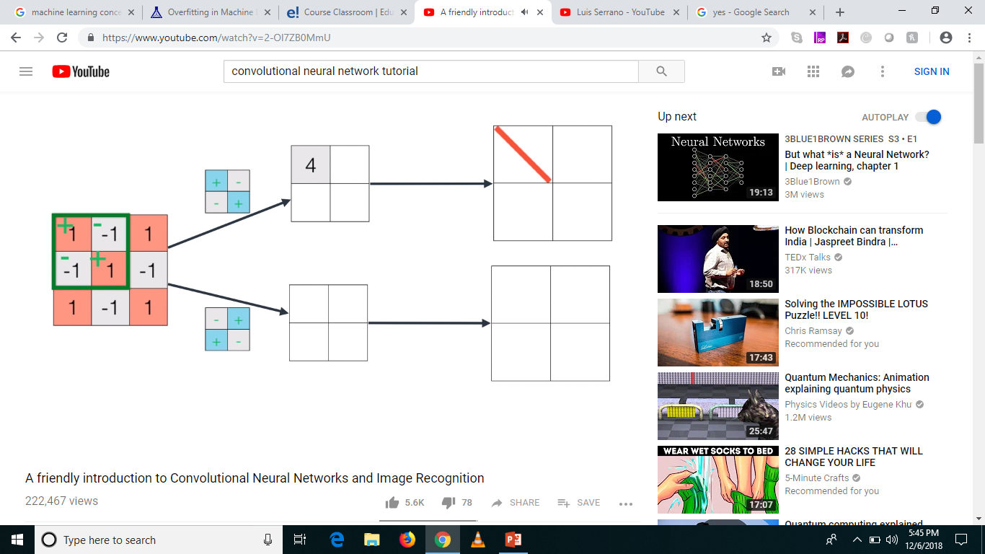

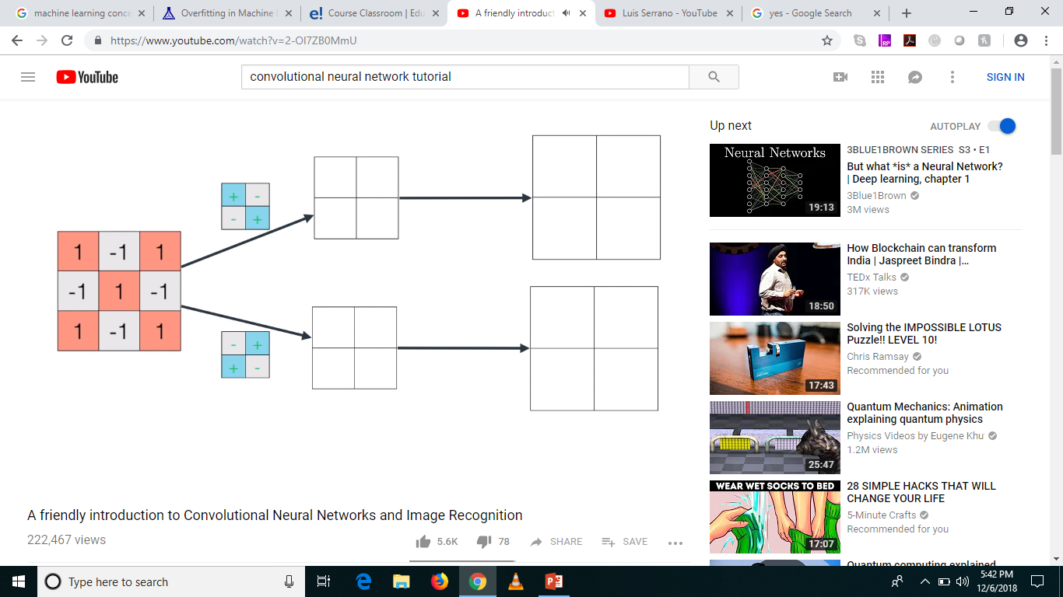
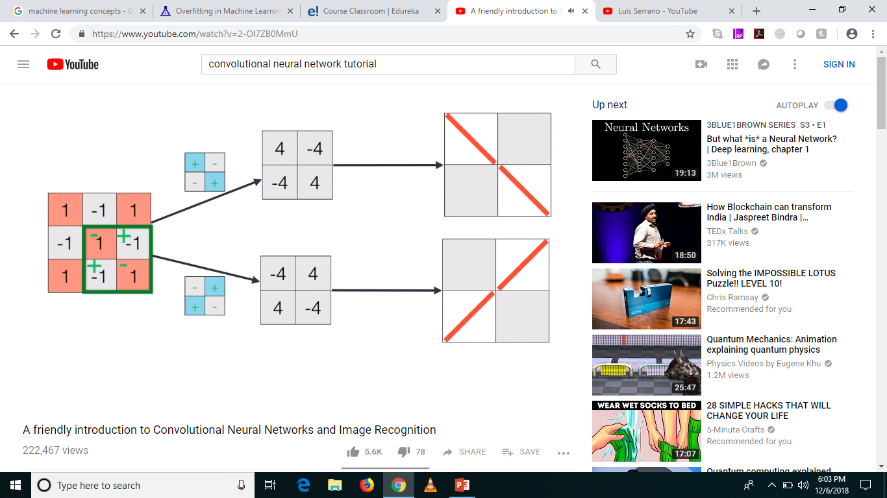


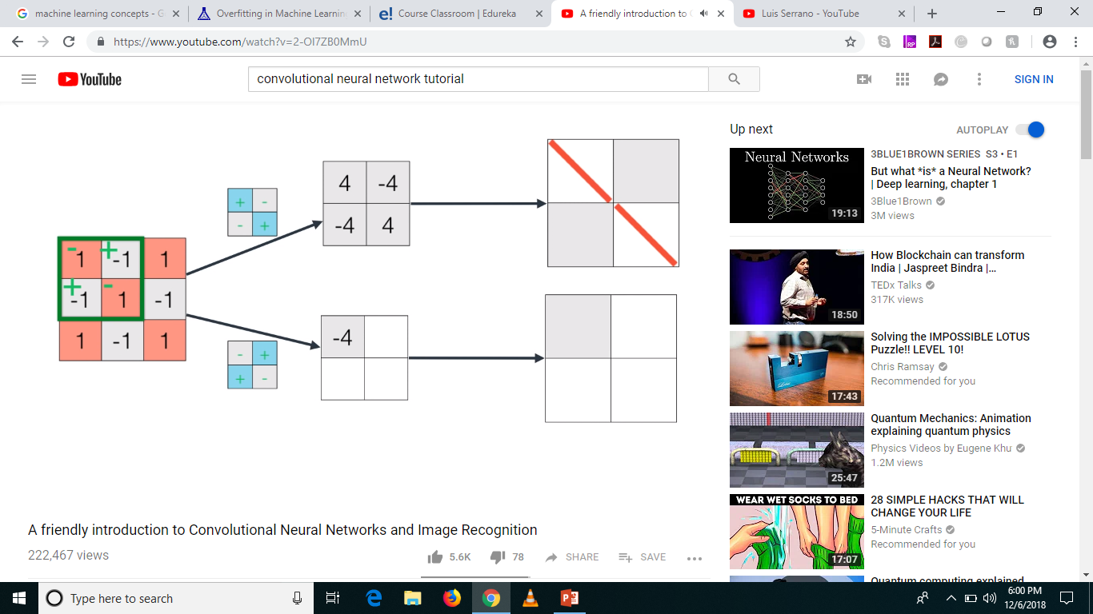
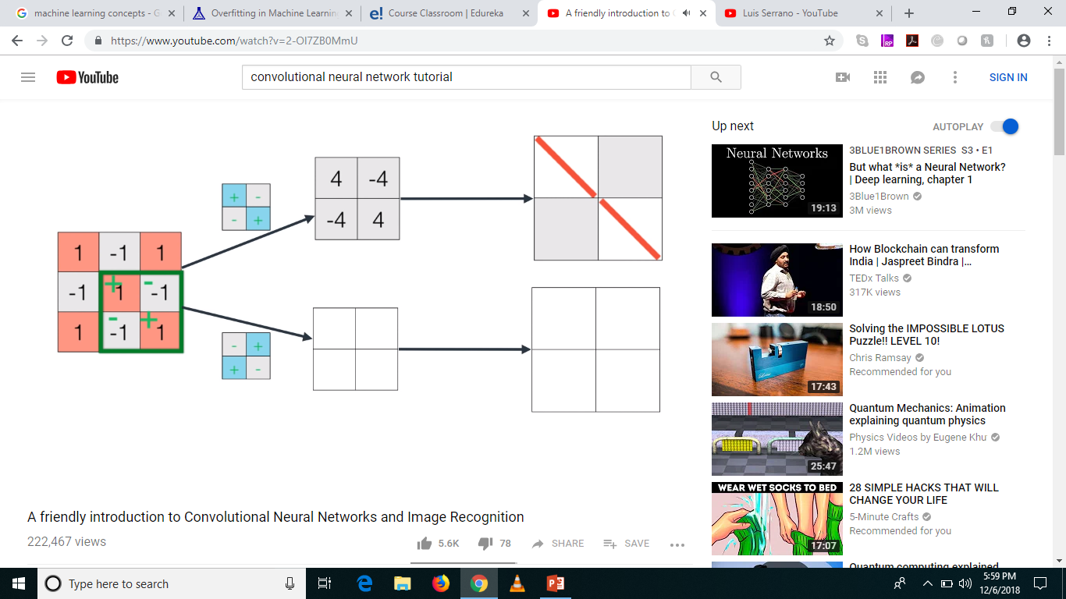

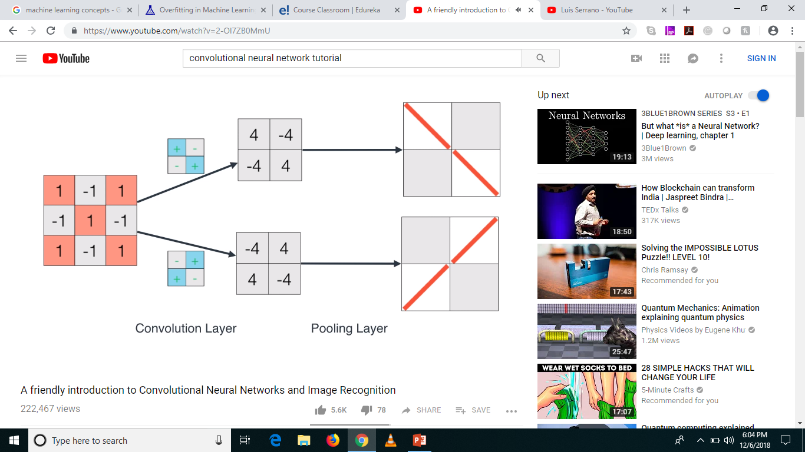
And Action!

Slide 26
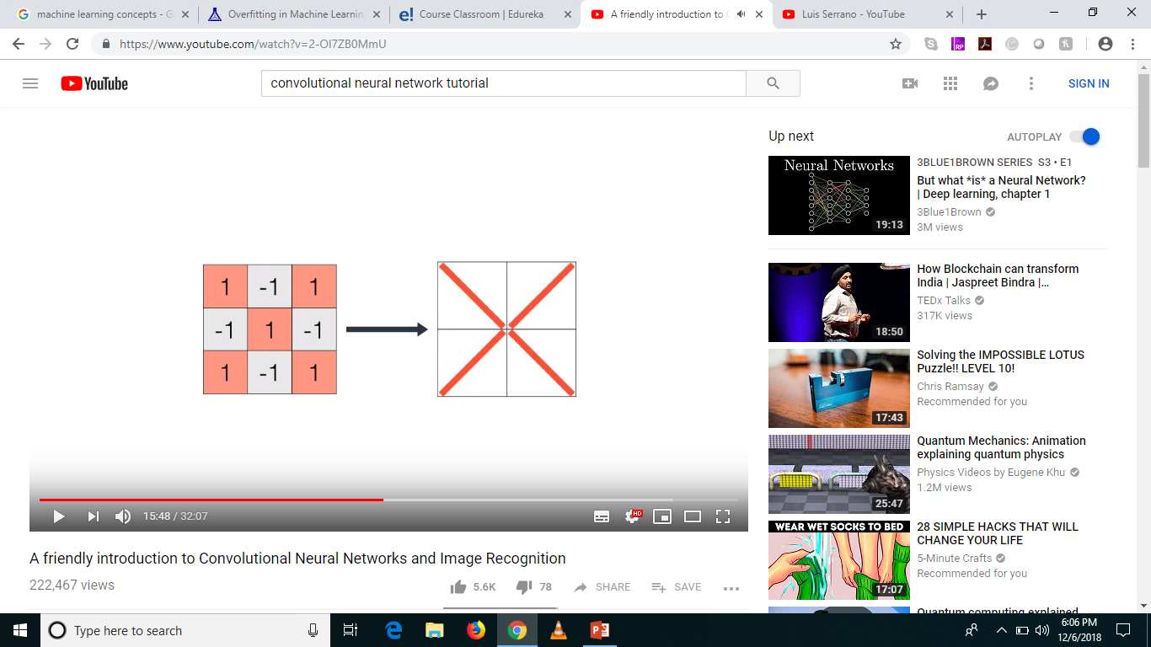
Superimpose

Slide 27
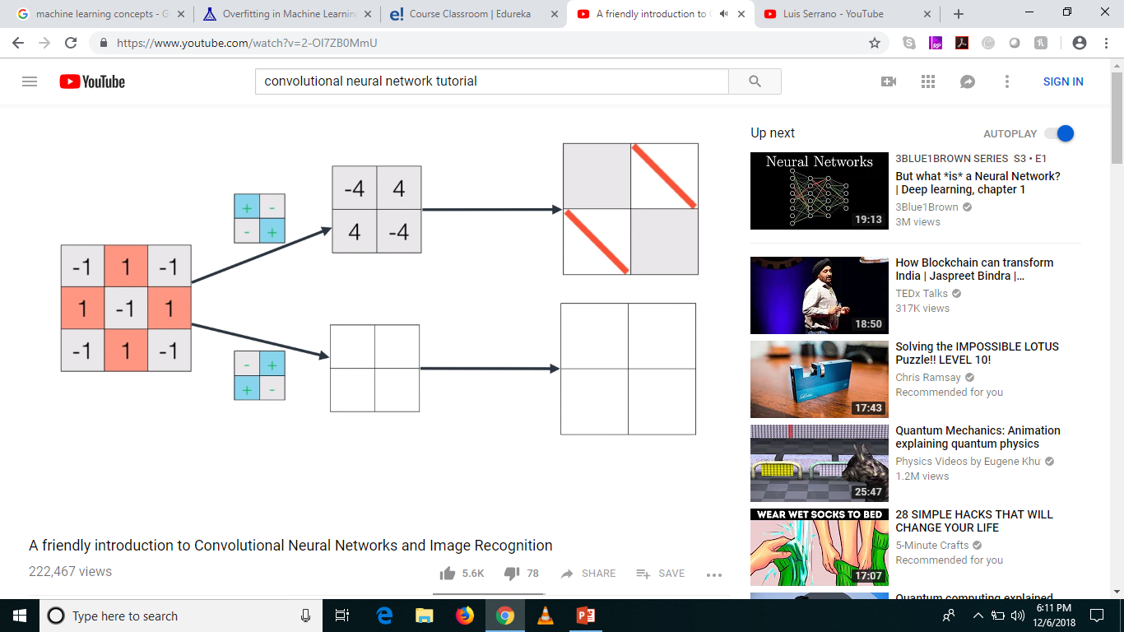
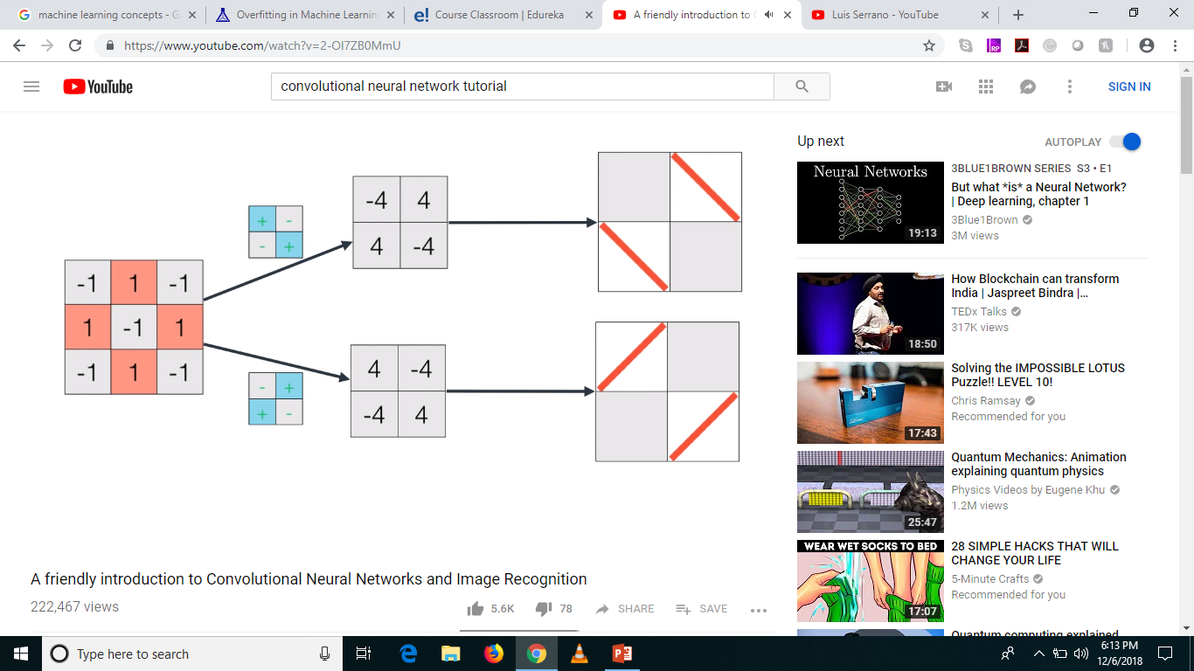
Recap with ‘O’

Slide 28

Superimpose

Slide 29
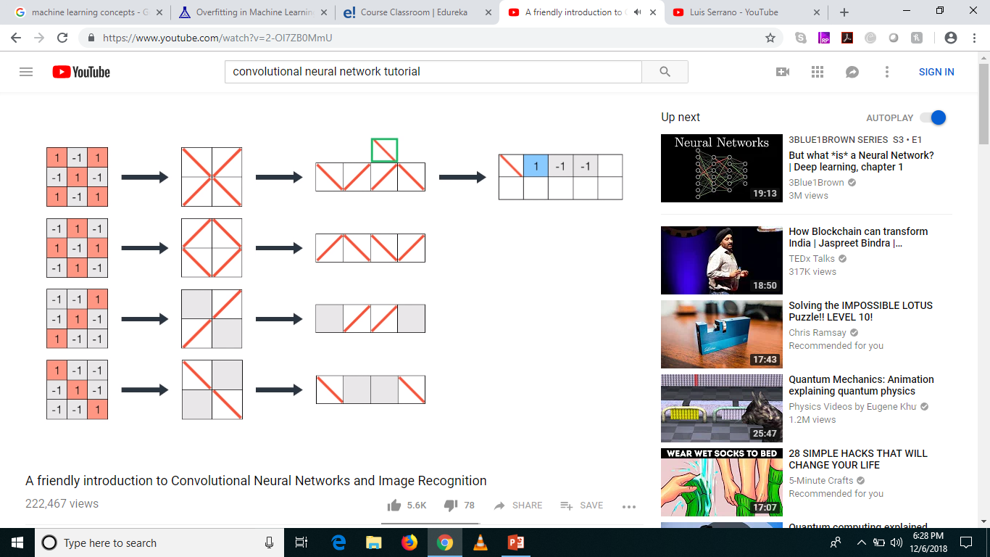




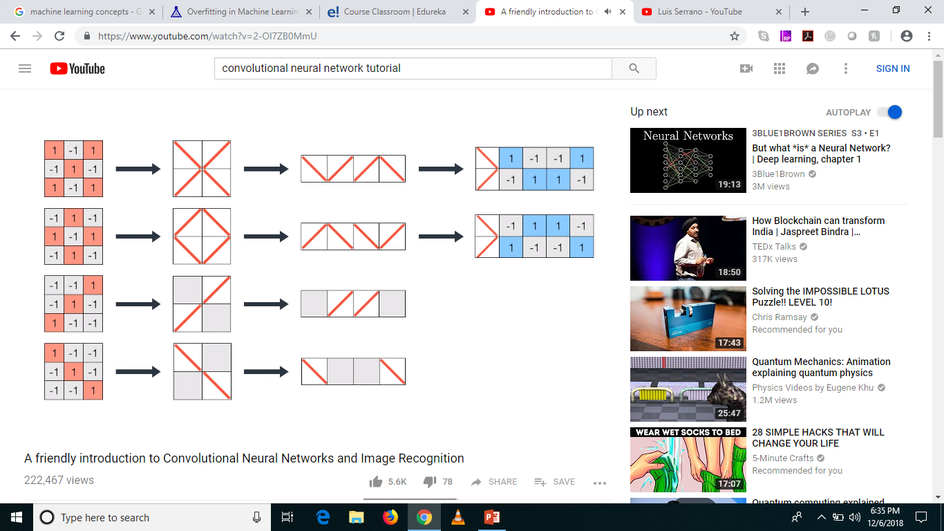



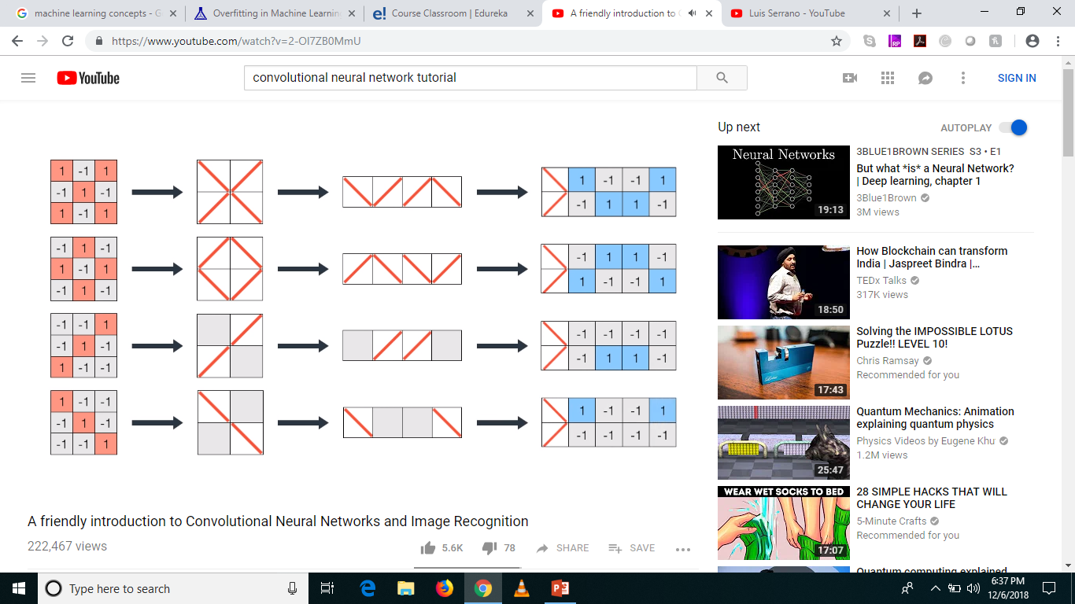
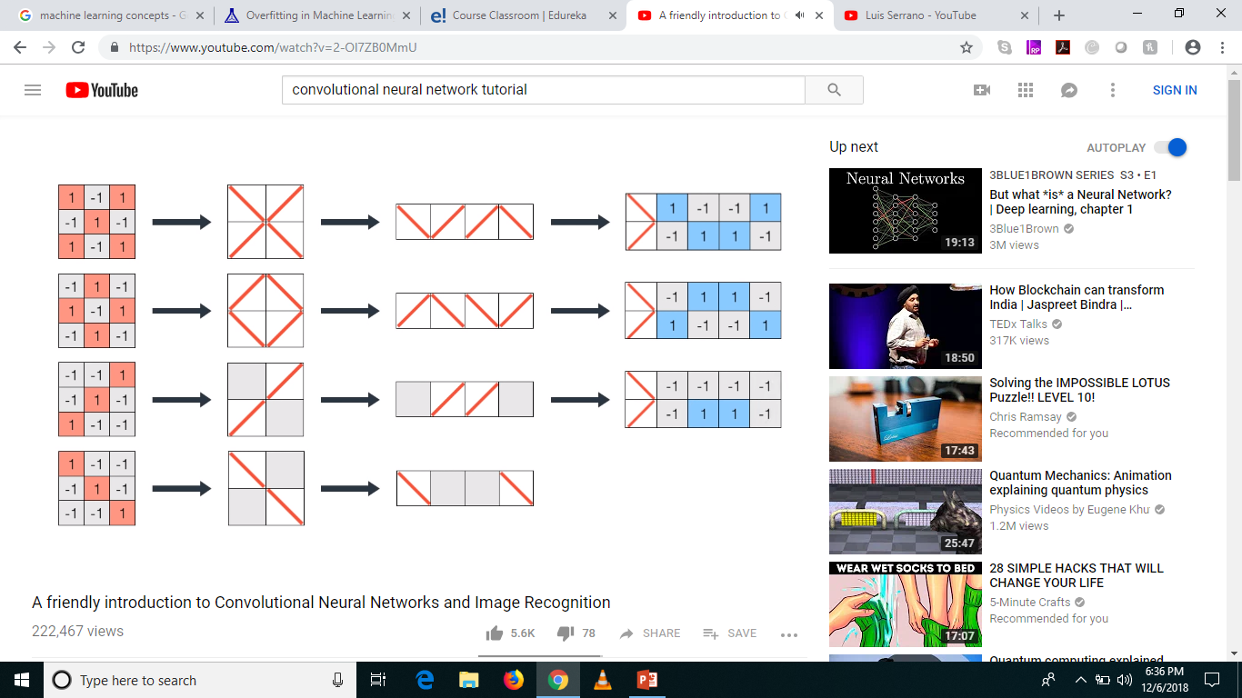
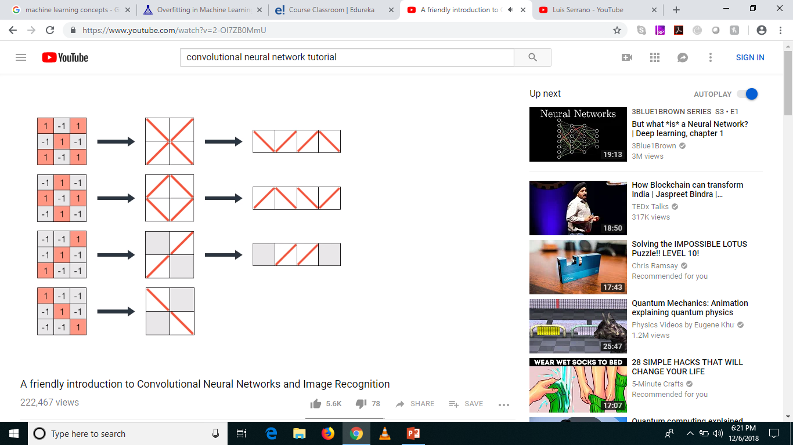
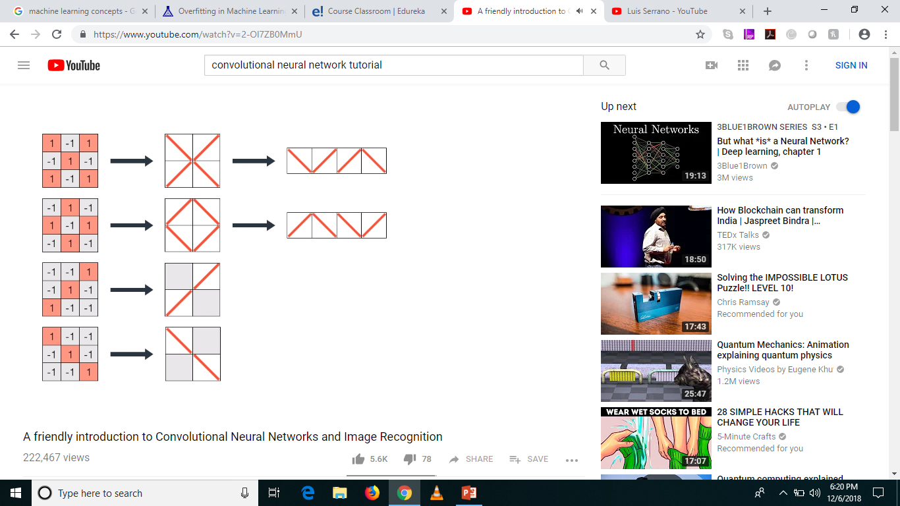
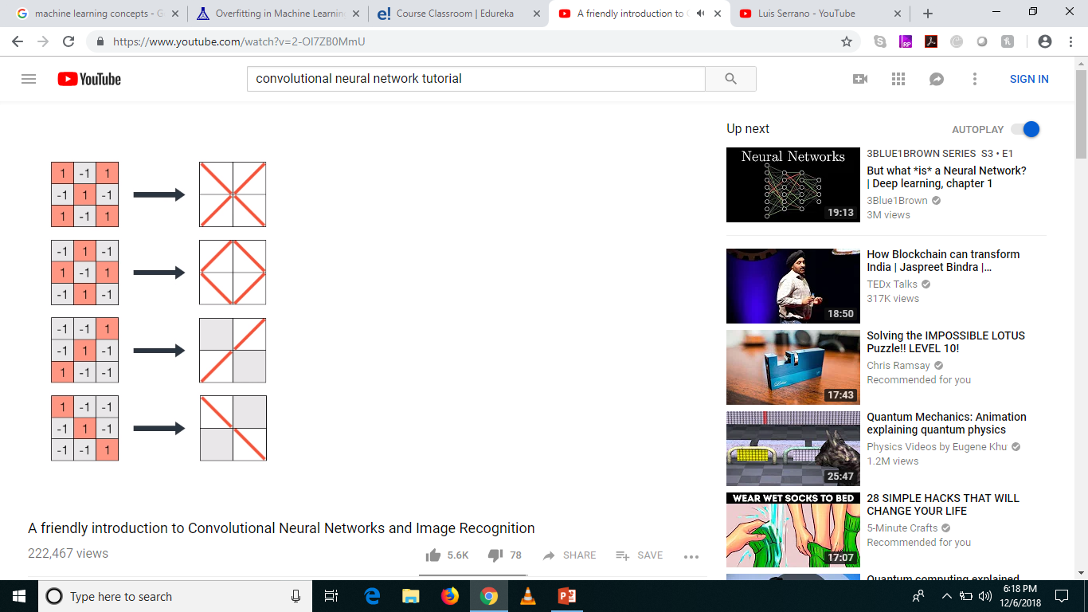

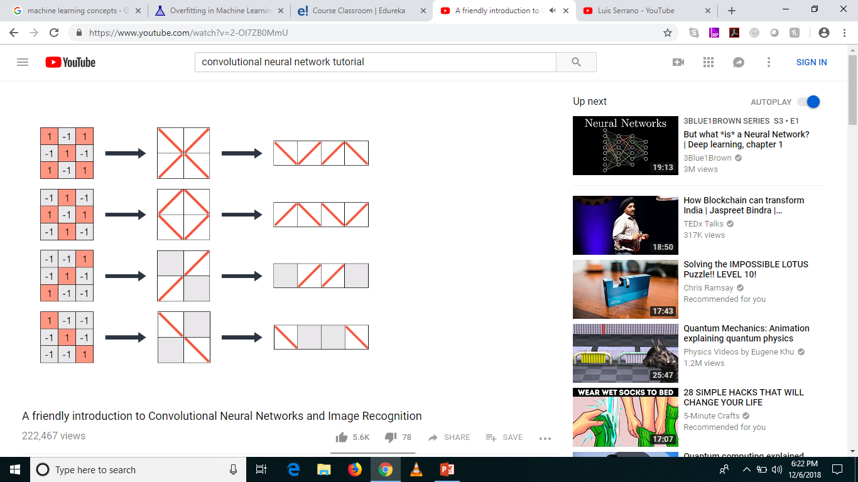

Fully Connected Layer?

Slide 30
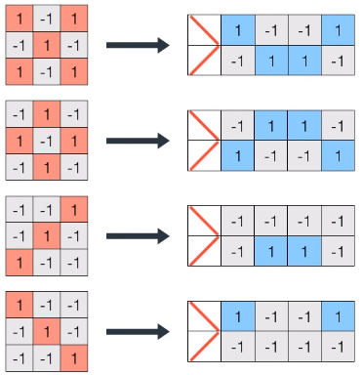
Transformation

Slide 31

Creating Filters

Slide 32




Classifying a new image – ‘X’
8
-8
4
4

Slide 33

Classifying a new image – ‘O’
-8
8
-4
-4

Slide 34

Classifying a new image – ‘/’

Slide 35

Classifying a new image – ‘\’

Slide 36

To Sum Up, what happens in a CNN?

Slide 37





And how does it happen?
Filters for
‘\’
Filters for
‘/’
Convolution Layer
Pooling Layer
Fully Connected Layer

Slide 38

So just for ‘X’

Slide 39


Gradient Descent, Again

Slide 40

Advanced World

Slide 41

To visualize CNN

Slide 42

Recognizing Faces

Slide 43
Questions?
Thank you!

